Slide 1
Lecture-3
8086 Microprocessor
Registers
MHK

Slide 2
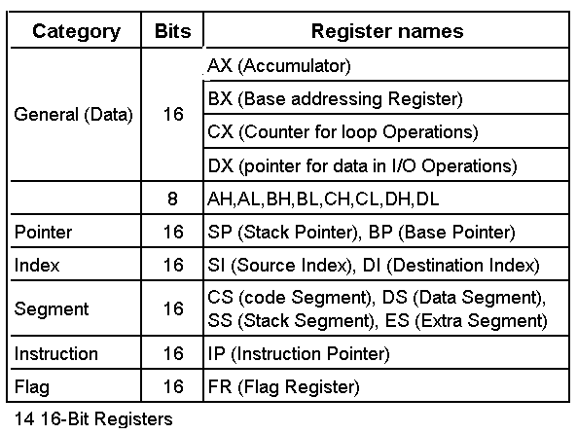
Registers of the 8086/80286
MHK

Slide 3
Intel 16-Bit Registers
General Purpose
AX
AH AL
15 8 7 0
BX
CX
AX
0
DX
MHK

Slide 4
General Purpose Registers
AX (Accumulator) – favored by CPU for arithmetic operations
BX – Base – can hold the address of a procedure or variable (SI, DI, and BP can also). Can also perform arithmetic and data movement.
CX – acts as a counter for repeating or looping instructions.
DX – holds the high 16 bits of the product in multiply (also handles divide operations)
MHK

Slide 5
Intel 16-Bit Registers
Segment
CS
SS
CS
0
DS
ES
MHK

Slide 6
Segment Registers
  Used as base locations for program instructions, data and the stack
CS – Code Segment – holds base location for all executable instructions in a program
SS - Base location of the stack
DS – Data Segment – default base location for variables
ES – Extra Segment – additional base location for memory variables.
MHK

Slide 7
Intel 16-Bit Registers
Index
BP
SP
BP
0
SI
DI
MHK

Slide 8
Index Registers
  Contain the offset of data(variables, labels) and instructions from its base segment.
BP – Base Pointer – contains an assumed offset from the SS register. Often used by a subroutine to locate variables that were passed on the stack by a calling program.
SP – Stack Pointer – Contains the offset of the top of the stack.
MHK

Slide 9
Index Registers
  Speed up processing of strings, arrays, and other data structures containing multiple elements.
SI – Source Index – Used in string movement instructions. The source string is pointed to by the SI register.
DI – Destination Index – acts as the destination for string movement instructions
MHK

Slide 10
Intel 16-Bit Registers
Status and Control
IP
IP
0
Flags
MHK

Slide 11
Status and Control Registers
IP – Instruction Pointer – contains the offset of the next instruction to be executed.
Flags Register – individual bit positions within register show status of CPU or results of arithmetic operations.
  Control Flags (Direction, Interrupt, Trap)
  Status Flags (Carry, Overflow, Sign, Zero, Auxiliary Carry, Parity)
MHK

Slide 12
Flags - Status
Carry (CF) – set when the result of an unsigned arithmetic operation is too large to fit into the destination.
Overflow(OF) – set when the result of a signed arithmetic operation is too wide to fit into the destination.
Sign(SF) – set when the result of an arithmetic or logical operation generates a negative result.
Zero(ZF) – set when the result of an arithmetic or logical operation is zero.
MHK

Slide 13
Flags – Status (cont)
Auxiliary Carry(AF) – set when the result of an operation causes a carry from bit 3 to bit 4.
Parity(PF) – reflects whether the number of 1 bits in the result of an operation is even or odd. 1 – odd, 0-even.
MHK

Slide 14
Flags - Control
Interrupt(IF) – dictates whether or not system interrupts can occur. 1 – enabled, 0 – disabled.
Trap(TF) – determines whether or not the CPU is halted after each instruction. Allows programmers to do tracing.
Direction(DF) – affects block data transfer instructions such as MOVS, CMPS. 0 – up, 1 – down.
MHK

Slide 15
Instruction Execution Cycle
Fetch the next operation
  Place it in the queue
  Update the program counter
Decode the Instruction
  Perform address translation
  Fetch Operands from memory
Execute the Instruction
  Perform the required calculation
  Store results in memory or registers
  Set status flags attached to the CPU
MHK

Slide 16
Absolute Address Calculation
Addresses can be interpreted in 2 formats:
  32-bit segment-offset address
    Combines a base location (segment) with an offset to represent a logical location (Example- 08F1:0100)
  20-bit absolute address (8086/88 has 20-bit address bus -> 1,048,576 different addresses)
    Refers to a physical address (09010)
MHK

Slide 17
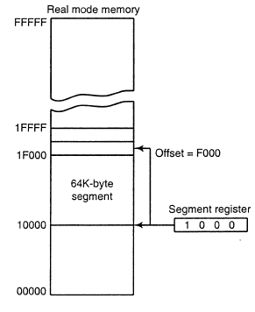
Segment and Offset Address
Segment Address defines the beginning of any memory segment.
Offset Address selects any location within this memory segment.
physical address=segment×10+offset
MHK

Slide 18
Calculation of Physical Address
Use segment value: 08F1
08F1 = 0000 1000 1111 0001
Multiply by 10
    08F1 x 10 = 08F10
Add the offset value: 0100
    08F10 + 0100 = 09010
Physical Address = 09010
MHK

Slide 19
Reversed Storage Format
When storing a word value in memory, the assembler reverses the bytes.
When the variable is moved to a 16-bit register, the CPU reverses the process.
The value 1234h is stored as:
  Offset: 00 01
  Value: 34 12
MHK

Slide 20
Thank You

